Slide 1
NEON Overview Slides
Name
Title
Date

Slide 2

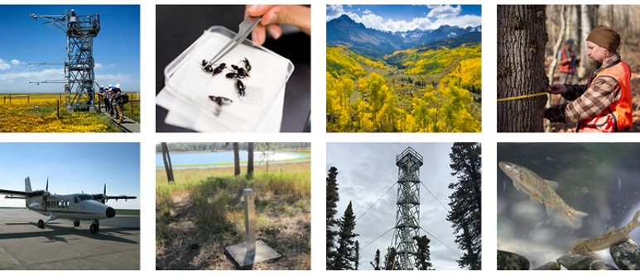
National Ecological Observatory Network (NEON)
…a continental-scale, long-term (30 year) Observatory, funded by NSF and operated by Battelle
Enables:
Analysis: Free and open data and samples on the drivers of and responses to environmental change ​
Comparison: Standardized and reliable framework for research and experiments​
Interoperability: Integration with other national and international network science projects​
Notes:
Battelle’s NEON program, fully funded by the National Science Foundation, enables large-scale ecological work - by virtue of scale of data and samples and through use of the infrastructure and other resources

Slide 3
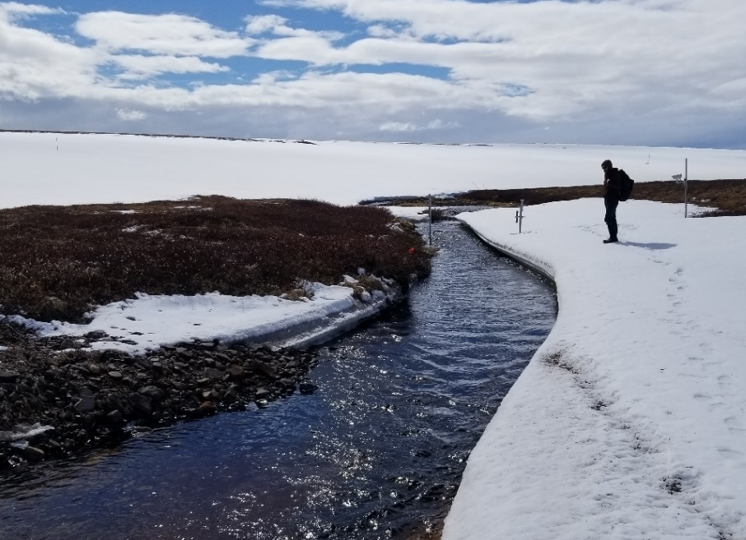
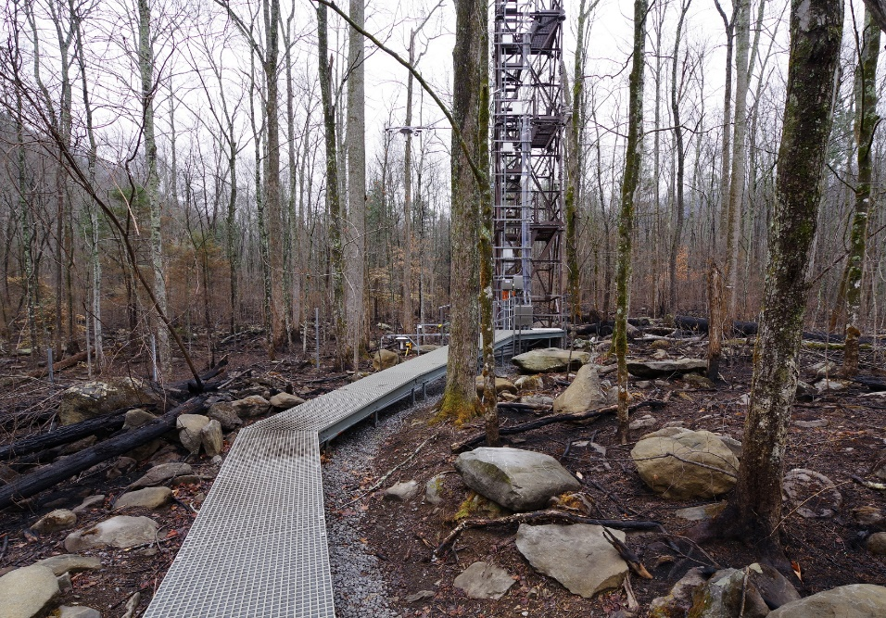
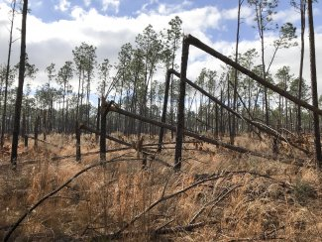
Why is NEON important for ecology?
NEON provides a highly coordinated national system for monitoring a number of critical ecological and environmental properties at multiple spatial and temporal scales.
Downed trees at The Jones Center at Ichauway
Ice breakup on Oksrukuyik Creek, AK
Fire damage at Great Smoky Mountains field site

Slide 4
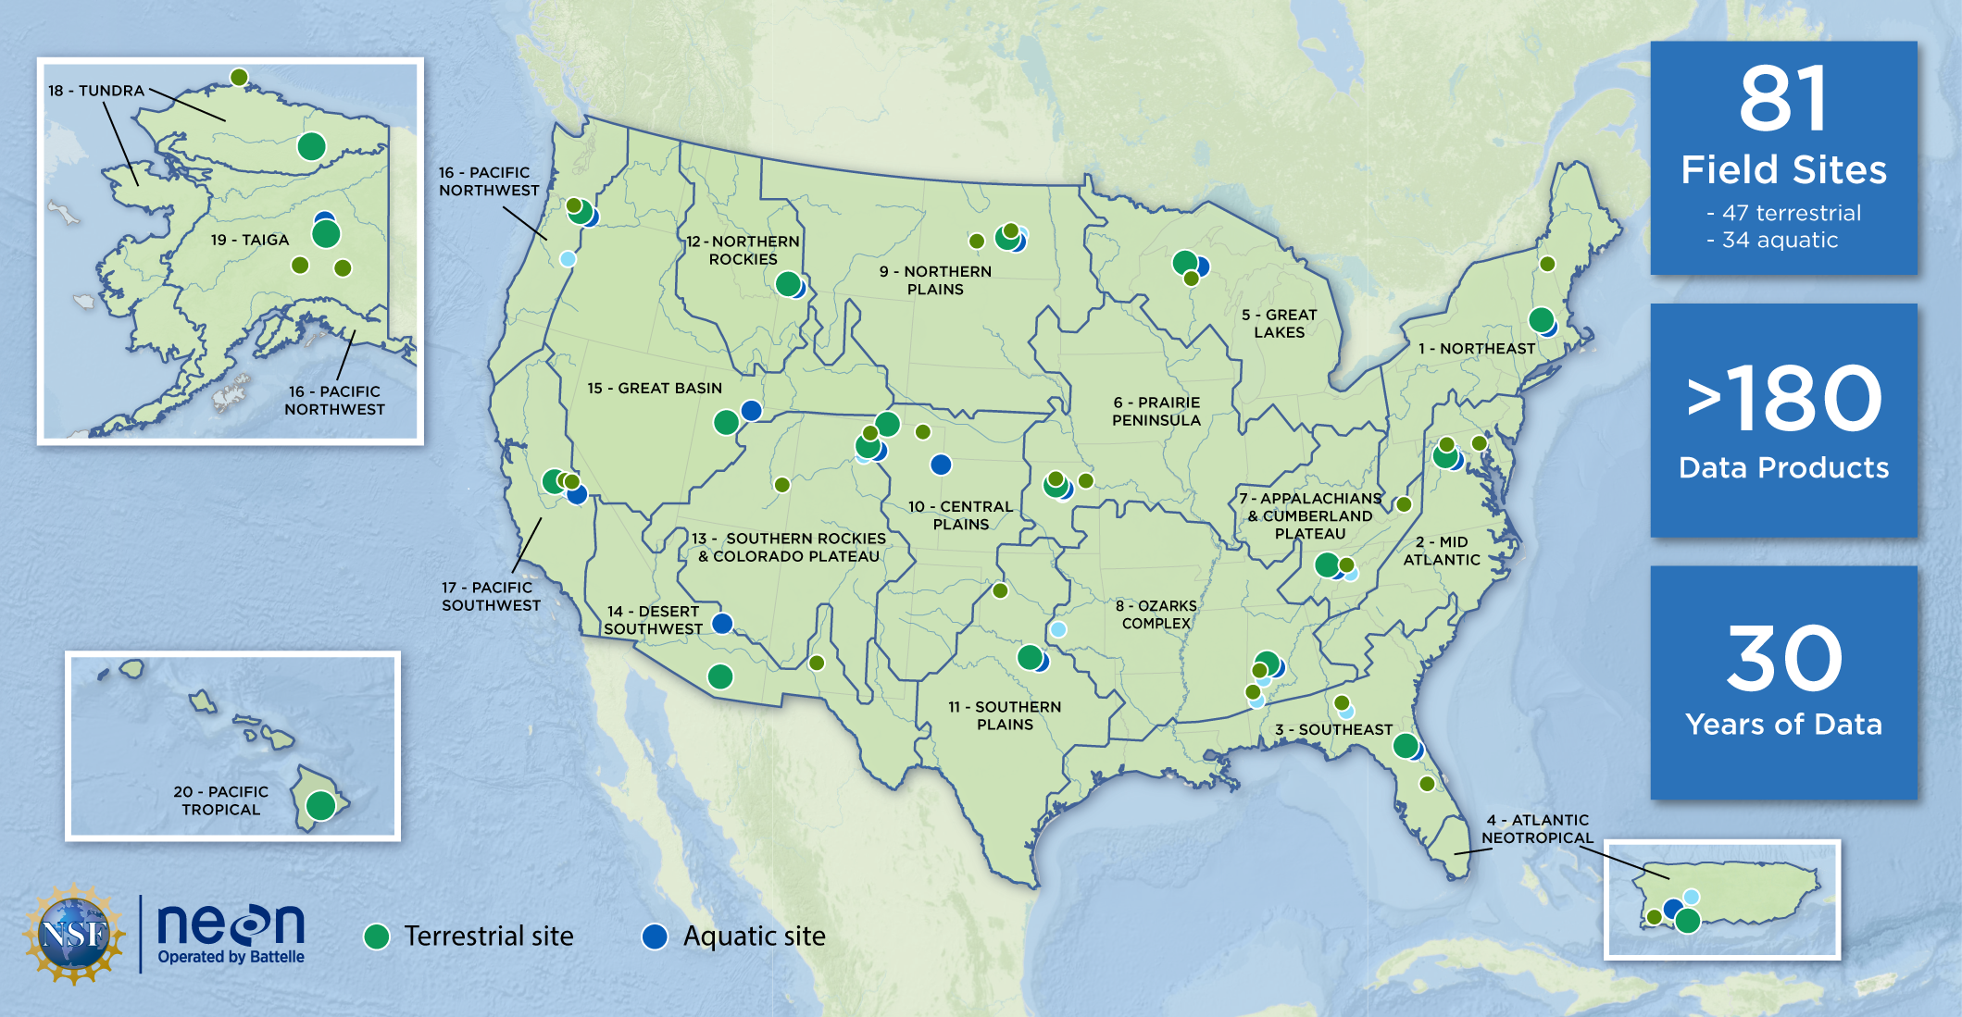
NEON is a distributed Observatory across the U.S.
FAIR & Open Data
Notes:
NEON is unique, an Observatory distributed across the U.S. including AK, HI, and PR - with 81 field sites (Terr and Aq), representing 20 broad eco-climatic domains. NEON provides a highly coordinated system of Open Data for monitoring over 180 critical ecological and environmental properties (or data products) at multiple spatial and temporal scales.​
NEON collects data over broad spatial and temporal scales to enable understanding of the key drivers and responses of environmental change across these scales
NEON collects data at 81 sites distributed throughout the 20 eco-climatic domains pictured here
And the intent is to collect data across these domains for 30 years, with the observatory becoming fully operational in 2019

Slide 5
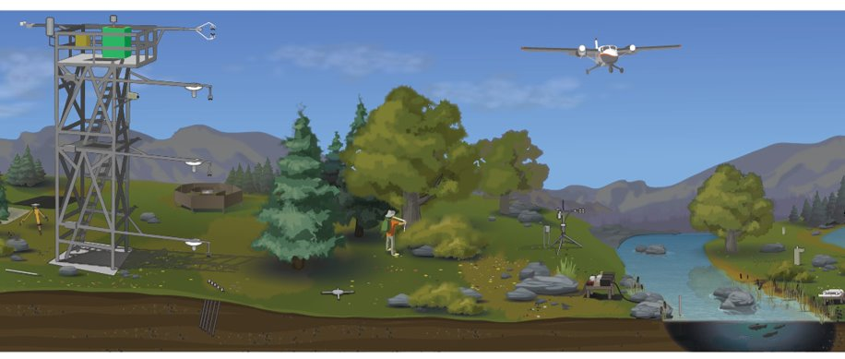
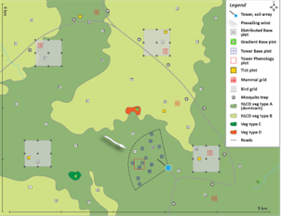
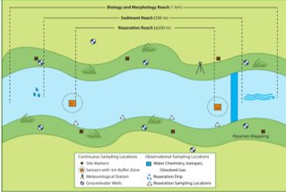
How we collect data and samples
Standardized, colocated methods across sites
Aquatic wadeable stream site
Terrestrial site
Notes:
collected using three different systems:
Automated instrument systems, which include meteorological and eddy flux data from the towers, phenocams, soil sensors, and ground and surface water sensors.
Observational sampling, which encompasses all of the observations and physical samples typically collected by people in the field. These include data e.g., from small mammal trapping; tick, mosquito and ground beetle sampling, etc.
Airborne Observation Platform: remote sensing using light aircraft carrying instrument payloads to gather photos, lidar and hyperspectral data.

Slide 6
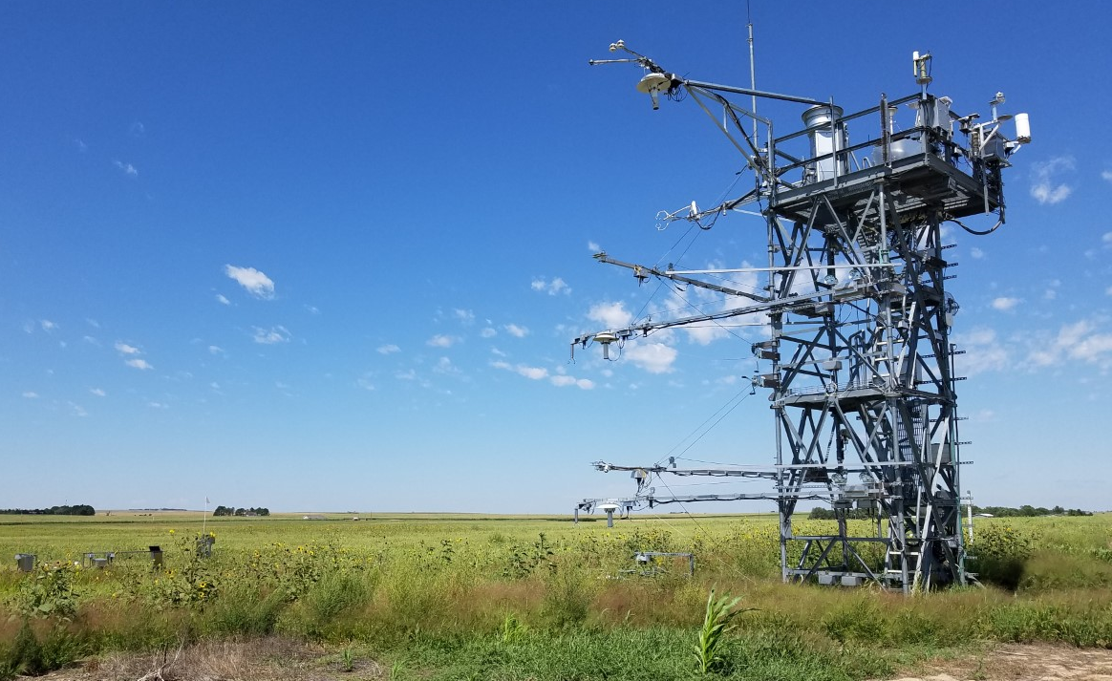
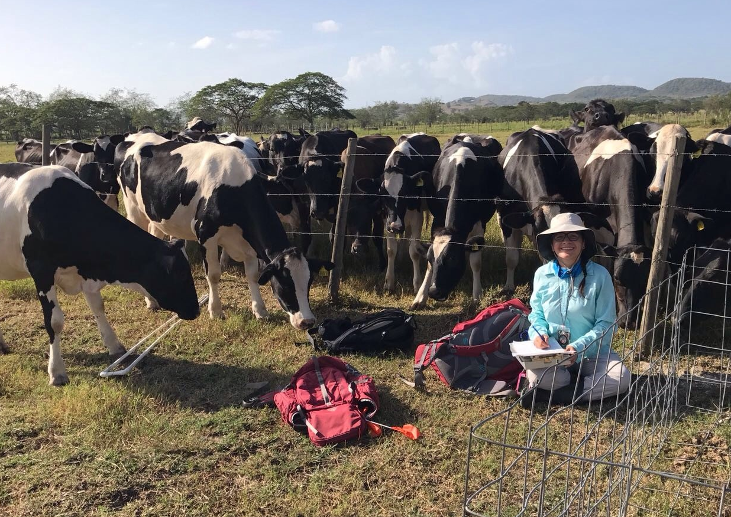
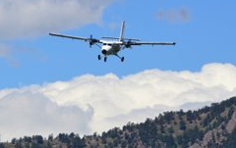
How we collect data and samples
Standardized, colocated methods across sites
Automated instrument systems
Observational sampling
Airborne observation platform
Notes:
collected using three different systems:
Automated instrument systems, which include meteorological and eddy flux data from the towers, phenocams, soil sensors, and ground and surface water sensors.
Observational sampling, which encompasses all of the observations and physical samples typically collected by people in the field. These include data e.g., from small mammal trapping; tick, mosquito and ground beetle sampling, etc.
Airborne Observation Platform: remote sensing using light aircraft carrying instrument payloads to gather photos, lidar and hyperspectral data.

Slide 7
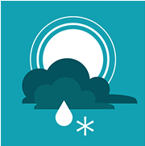


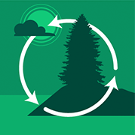

>180 Data Products
Atmospheric
Organismal
Ecohydrology
Biogeochemistry
Remote Sensing
H₂O, CO₂
Heat
Micromet
Isotopes
Turbulence
Storage
Fluxes
Abundance
Composition
Biomass
Productivity
Pathogens
Phenology
Marker Genes
Metagenomics
Water quality
Precipitation
Discharge
Radiation
Geomorphology
Riparian Structure
Soil conditions
Chemistry
Particulates
Foliar characteristics
Spectrometry
Hi-Res Imagery
LiDAR
Notes:
Together, from three methods, Currently 182 dp. Standardization allows interoperability across data, across sites.
The data in a Release will never change and each data product will have an associated DOI for each Release – enables reproducibility
Through the DOIs, will be able to track the DOIs and impact
Data delivered to date are to be considered provisional – that is, subject to change as a result of data availability and quality reviews
Releases are planned to occur annually thereafter
The data in a release will never change and each data product will have an associated DOI for each release – enables reproducibility
More info:
https://www.neonscience.org/data/about-data/data-processing-publication

Slide 8
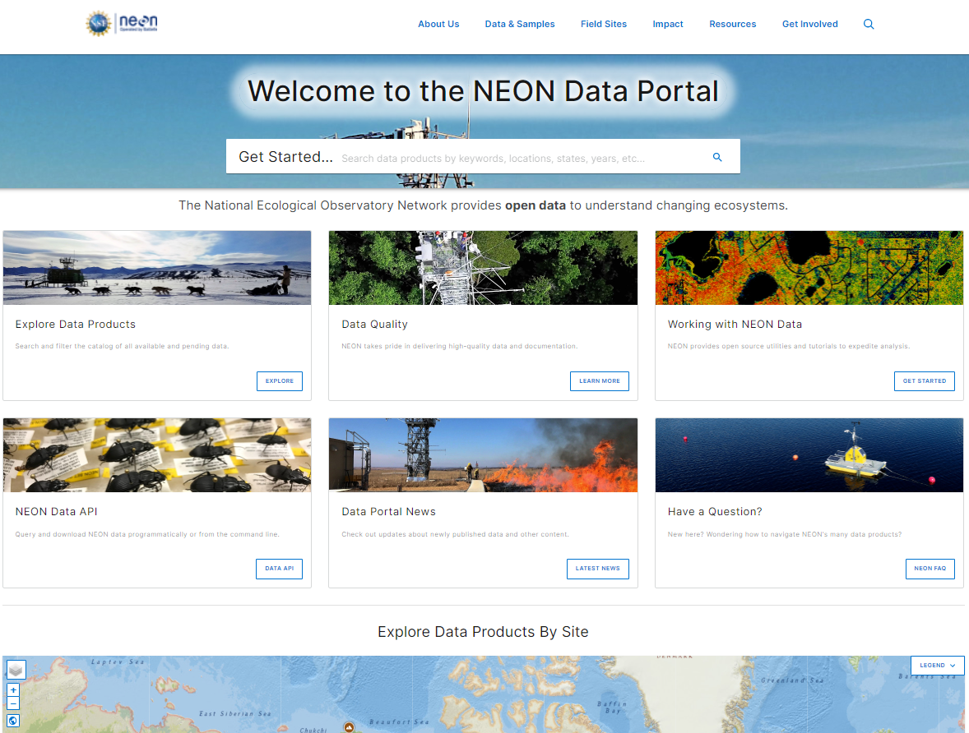
Data portal: data.neonscience.org
Explore and download FREE data
Information on programmatic access to NEON data
  API
  Code packages
Access data product user guides, detailed protocols, and other important documents

Slide 9
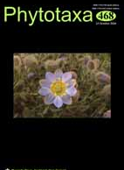


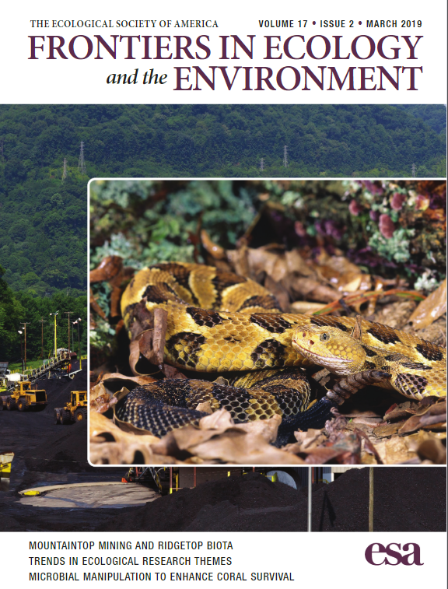


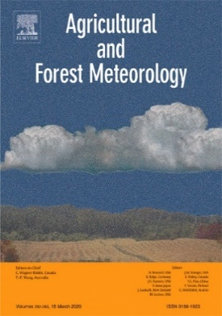




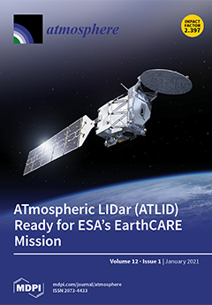
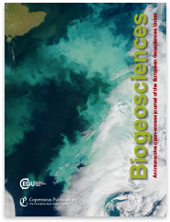
Research enabled by NEON data & specimens
For NEON publications visit: https://www.neonscience.org/impact/papers-publications
Notes:
Research using NEON data and specimens is sharply climbing. Publications per year nearly tripled in 2021 over previous year, and marks greater usage of NEON data and resources since full operations in early 2019 (small lag, perhaps due to beginning of pandemic in 2020?)

Slide 10
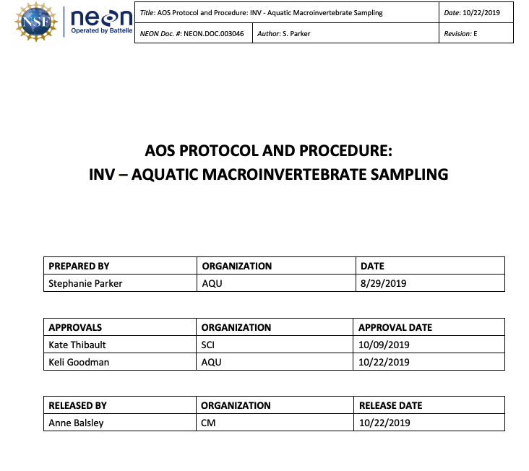
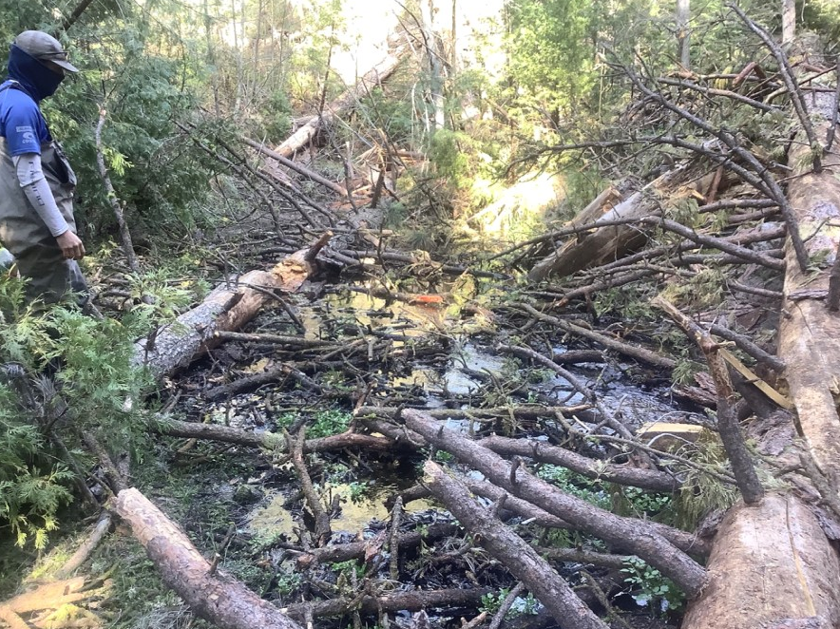
Standardized protocols
NEON Aquatic macroinvertebrate sampling protocol
Winter tree fall covering Upper Big Creek, CA (2019)
https://data.neonscience.org/data-products/DP1.20120.001
Notes:
Upper Big Creek (BIGC) is an aquatic NEON field site located in central California. It is a wadeable stream on the western slope of the Sierra Nevada Mountains
Here is a before (2019) and after (2021) photo from the D17 example I was talking about. These trees came down over the winter, this 2021 photo was taken during their spring sampling.
To take this one step further, we have field science collect from the 2 most dominant habitat types (riffles, runs, pools) in a stream for the biological data products. The field scientists at BIGC after sending me this photo, thought that the habitat percentages had changed and that they should change their standard sample design to fit that. But we have an annual “rapid habitat assessment” protocol that they perform where they measure the size and characteristics of each habitat unit along the 1 km stream reach. When I analyzed the rapid habitat data from 2021, we found that there was no actual change in habitat percentages, it just looked like it changes to their eyes because of the trees in the channel. So using one of our standard protocols, we were able to verify that their normal sample design was still valid to use at the site and no change was warranted and they were able to continue sampling the same way as previous years, albeit around the downed trees, for their summer bout. (Stephanie Parker)

Slide 11

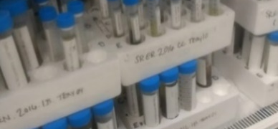
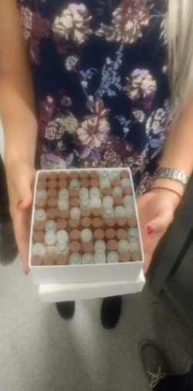
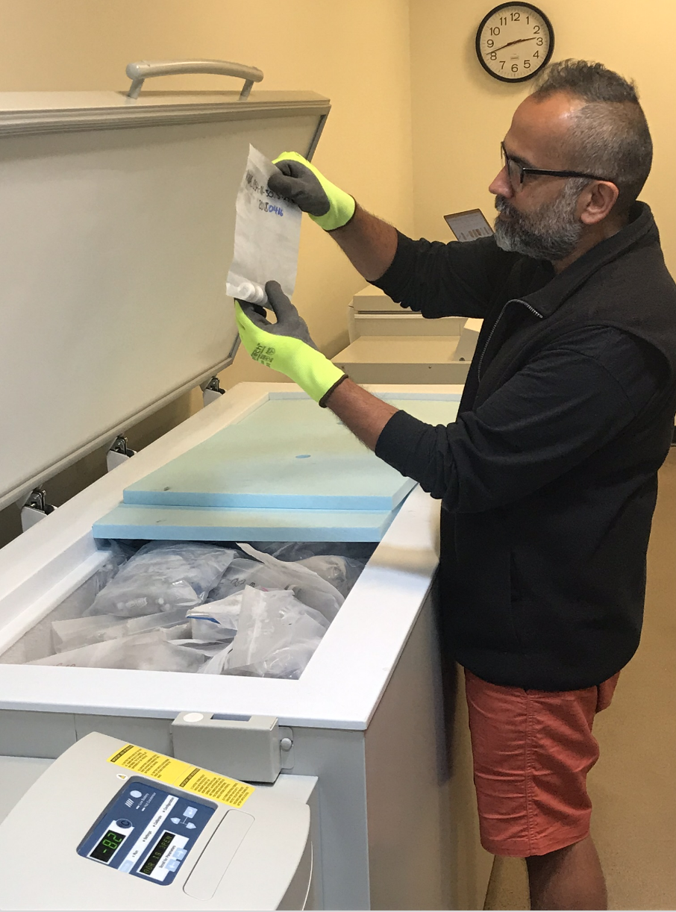
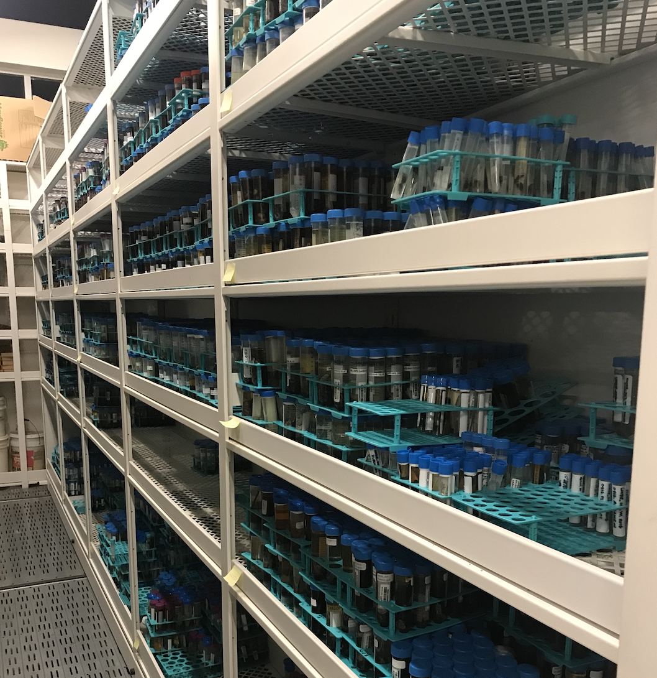
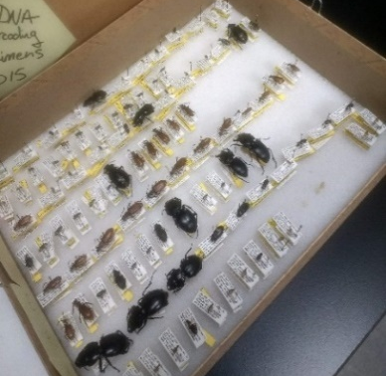

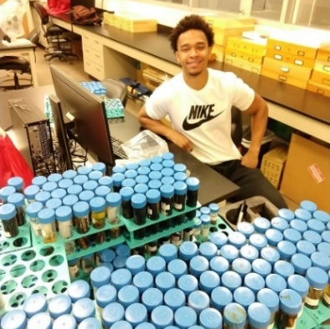
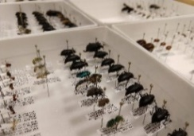
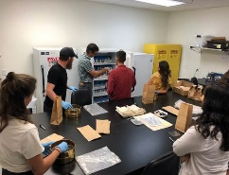
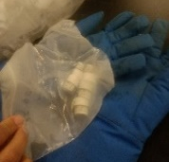
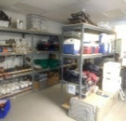
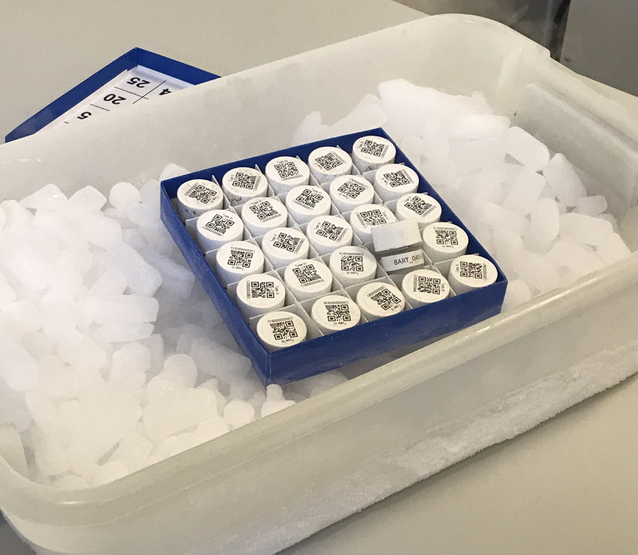


NEON specimens & samples: NEON Biorepository
100,000 specimens & samples/year
Small mammals
Fishes
Ground beetles
Mosquitos
Ticks
Zooplankton
Benthic macroinvertebrates
Vascular plants, algae, bryophytes and lichens
Soil microbes
Soil
Dust
Wet deposition
65 sample types
biorepo.neonscience.org
Notes:
We partner with Arizona State University to manage the NEON Biorepository where most of our diverse array of samples are ultimately curated. NEON collections are primarily archived at the NEON Biorepository located in Tempe, Arizona at the ASU Natural History Collections. Currently, more than 200,000 NEON specimens are archived at this facility.
Notwithstanding the restrictions to our collection efforts due to COVID, NEON will archive between 80 and 120k specimens annually – stored in conditions meant to maximize their long-term data potential. NEON Biorepository data visibility and discoverability is greatly increased by publishing to data aggregators.
Over 60% of samples are cryo!
organismal samples
frozen soils,
and dust filters that complement the National Atmospheric Deposition Program’s existing repository.
Some samples collected prior to 2018 have been archived at other institutions, as described on our website. Both NEON staff and Nico Franz at ASU are available to assist anyone interested in using NEON samples.

Slide 12
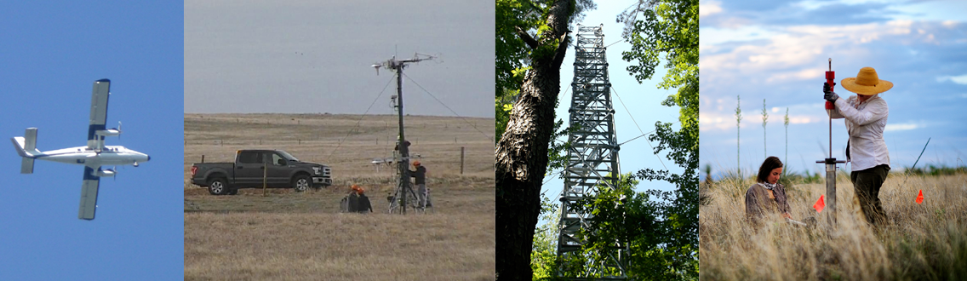
Enhance your science with NEON infrastructure
Access to Observational Sampling Infrastructure (staff and resources)
Access to Sensor Infrastructure
Airborne Observation Platform
Mobile Deployment Platforms
PI Research –
Assignable Assets
Notes:
Also, a lot of our resources are available to researchers through Assignable Assets. AA is an important program for the community – requests for assets, on a cost-recoverable basis, are increasing each year.
Can request
Access to Observational Sampling Infrastructure at Field sites, e.g., field technician support for their project. Researchers may request access to sampling locations or field technician support for PI-led projects at NEON sites.
Access to Sensor Infrastructure (SI) at Field Sites: I add sensors to existing NEON field site infrastructure, e.g., the flux towers, soil arrays, etc.
Airborne Observation Platform (AOP) Surveys: Researchers can request to fly non-NEON sites or to fly NEON sites at times of year when NEON does not collect AOP data; remote sensing data
Mobile Deployment Platforms: ..self-contained mobile sensor arrays can be set up to collect sensor data that NEON towers do. Can collect meteorological, soil and surface water data for short- to medium-term monitoring projects. MDPs are designed for rapid deployment to be able to capture stochastic ecological events (e.g. fires, flood events, pest outbreaks) across the landscape. These platforms are designed for rapid deployment - perturbations.
AA is a major way that NEON can enable your science

Slide 13
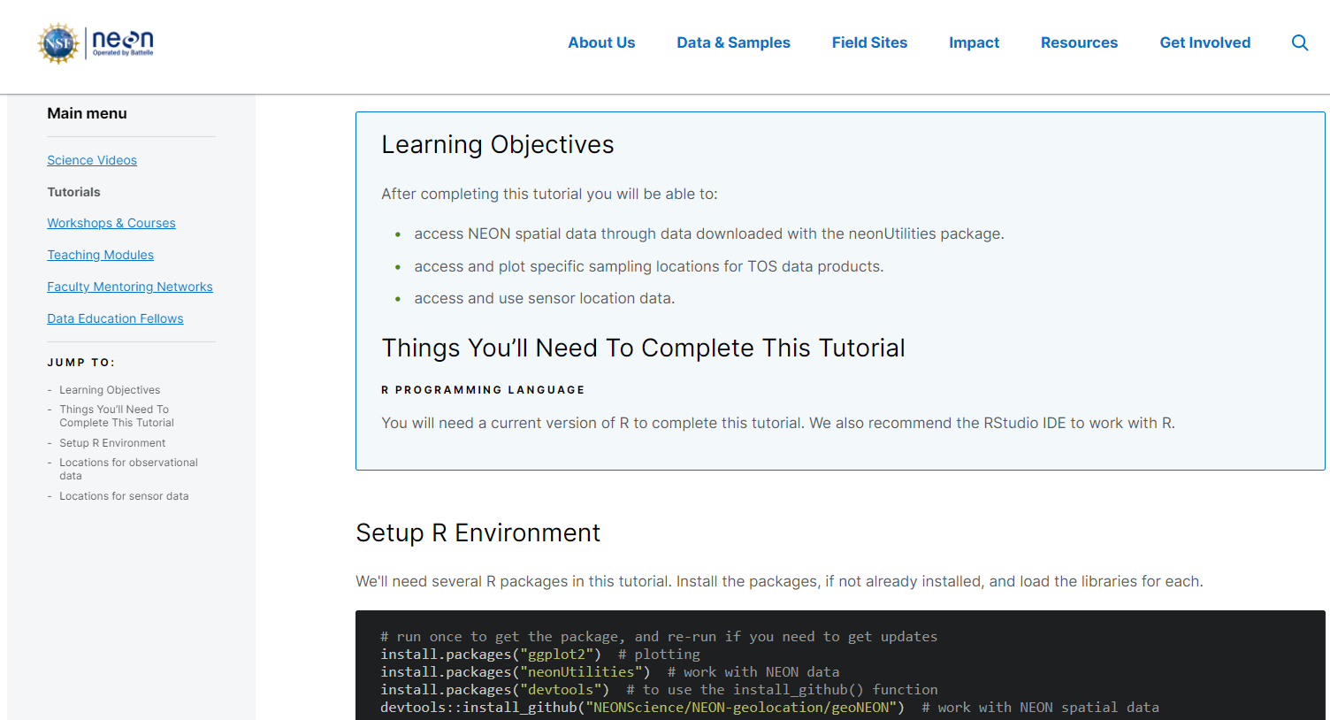
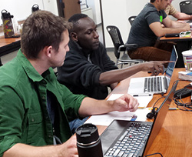
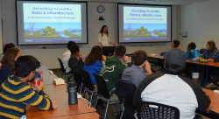
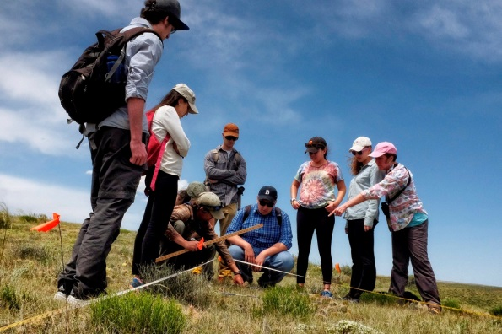
Learn & Experience
NEON
Teaching Modules
Data Skills Workshops
Science Videos
Community Code
Seasonal Fieldwork
Self-paced Tutorials
Notes:
Also, a lot of our resources are available to researchers through Assignable Assets. AA is an important program for the community – requests for assets, on a cost-recoverable basis, are increasing each year.
Can request
Access to Observational Sampling Infrastructure at Field sites, e.g., field technician support for their project. Researchers may request access to sampling locations or field technician support for PI-led projects at NEON sites.
Access to Sensor Infrastructure (SI) at Field Sites: I add sensors to existing NEON field site infrastructure, e.g., the flux towers, soil arrays, etc.
Airborne Observation Platform (AOP) Surveys: Researchers can request to fly non-NEON sites or to fly NEON sites at times of year when NEON does not collect AOP data; remote sensing data
Mobile Deployment Platforms: ..self-contained mobile sensor arrays can be set up to collect sensor data that NEON towers do. Can collect meteorological, soil and surface water data for short- to medium-term monitoring projects. MDPs are designed for rapid deployment to be able to capture stochastic ecological events (e.g. fires, flood events, pest outbreaks) across the landscape. These platforms are designed for rapid deployment - perturbations.
AA is a major way that NEON can enable your science

Slide 14
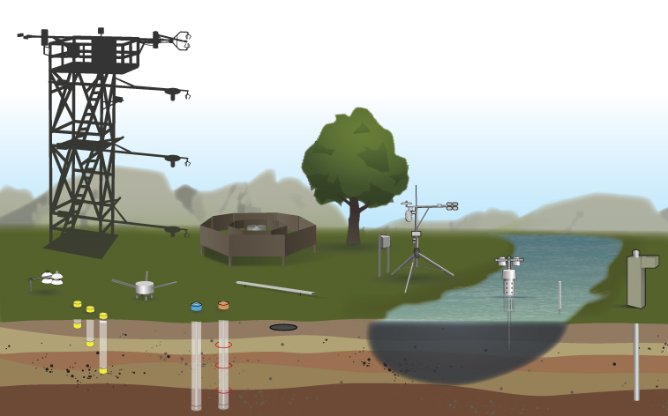
NEON data are linked
Temperature
PAR
CO₂
Notes:
The NEON instrument & spatial design allows for measurements to be linked within and across field sites. Here we show a hypothetical, colocated terrestrial and aquatic site..
For example, temperature measurements are taken at multiple levels in both terrestrial and aquatic sites and can be used to look at independent or co-varying changes in temperature over time.
Remember that as these data stream in, in close timing - the beetles are being collected, the stream invertebrates sampled, and the remote sensing of the site from the airpla
Temperature measurement specifics:
Tower: Air temperature, single (NEON.DP1.00002) & triple aspirated (NEON.DP1.00003); IR biological temperature (NEON.DP1.00005), at the top and at the levels along the tower.
Soil Array: soil temperature at multiple depths (NEON.DP1.00041)
Aquatic met station: Air temperature, single (NEON.DP1.00002) & triple aspirated (NEON.DP1.00003)
Aquatic water bodies: surface temperature (NEON.DP1.20053), temperature at depth (NEON.DP1.20264) & air temperature at buoys (NEON.DP1.20046; not shown in diagram)
Groundwater wells: ground water temperature (NEON.DP1.20217)

Slide 15

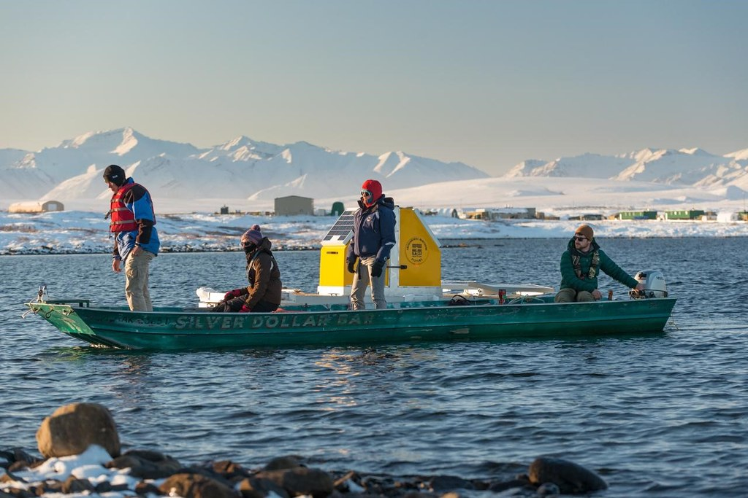
Data for climate change
Retrieving the Buoy at Toolik Lake, AK
Ice breakup on Oksrukuyik Creek, AK

Slide 16

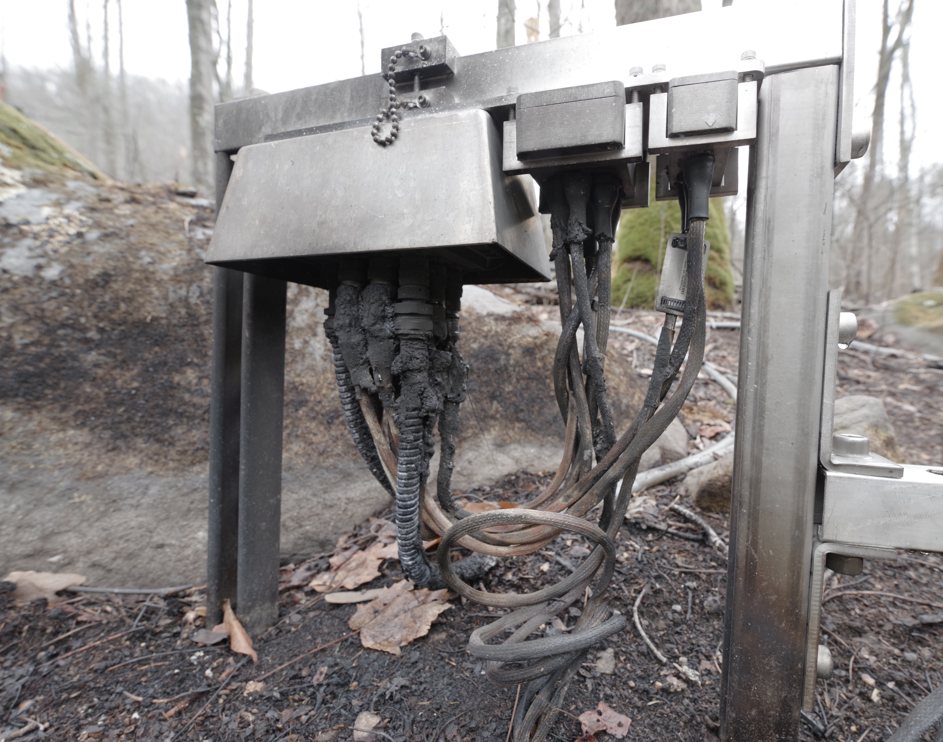
Data that spans natural disasters
GRSM 2016 Wildfires aftermath
Fire damage on soil sensor array at Great Smoky Mountains field site from the east Tennessee wildfires

Slide 17
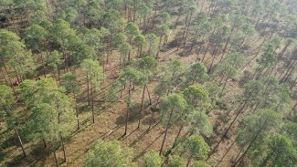
Data that spans natural disasters
Aftermath of Hurricanes
Downed trees at The Jones Center at Ichauway in the wake of Hurricane Michael in 2018. Photo credit: The Jones Center at Ichauway.
Notes:
The Jones Center is home to one of the largest mature longleaf pine and wiregrass ecosystems remaining in the southeast. The 30,000-acre preserve (the host for NEON’s JERC field site) is dedicated to the conservation of this unique ecosystem and development of sustainable forest management practices.
Hurricane Michael left the landscape significantly changed. Jeffery and his colleagues estimate that 15-20% of the total trees across the preserve were downed by hurricane-force winds. After the storm, more than 4500 truckloads of recoverable timber were removed from the site, according to the conservation coordinator at the Jones Center, Brandon Rutledge.’
Nearly two years later, the legacy of the hurricane can still be clearly seen by those who know what to look for. While most timber and debris have been removed near roads, thousands of downed trees remain in areas that were not accessible for the logging trucks. There are also splintered tree stumps, “tip-up” mounds where root balls were pulled from the earth, and slash piles of unharvestable wood and brush throughout the less accessible areas of the forest. “In some areas, it’s like a ropes course walking through the tangled downed tree crowns,” Jeffery says. “Legacies of the hurricane will remain in some of these areas for decades to come.”
The hurricane substantially changed the overall structure of the forest, leaving large gaps in the canopy in some places while leaving other areas largely intact. The researchers at The Jones Center are working to understand these structural changes and monitor the recovery of the longleaf pine ecosystem. They also want to answer the critical question: what should forest managers be doing now?

Slide 18
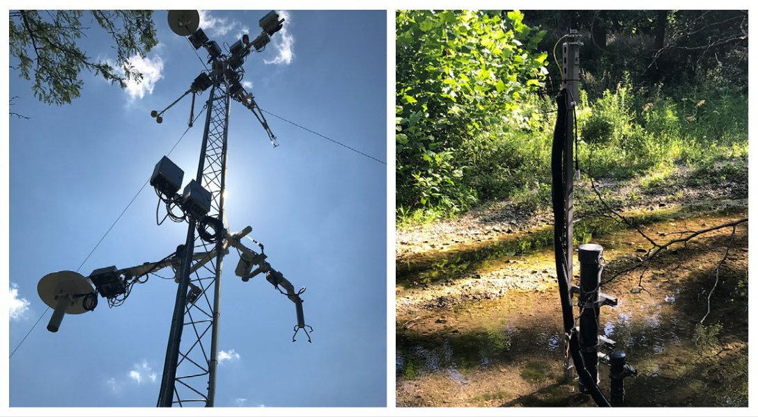
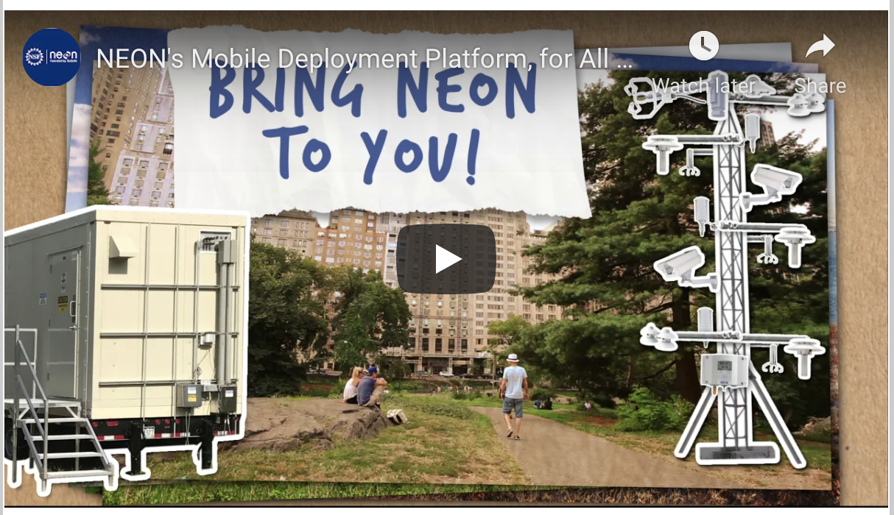
Fast response: MDPs to study ecological disturbances
https://youtu.be/70ms9g8J7WY

Slide 19
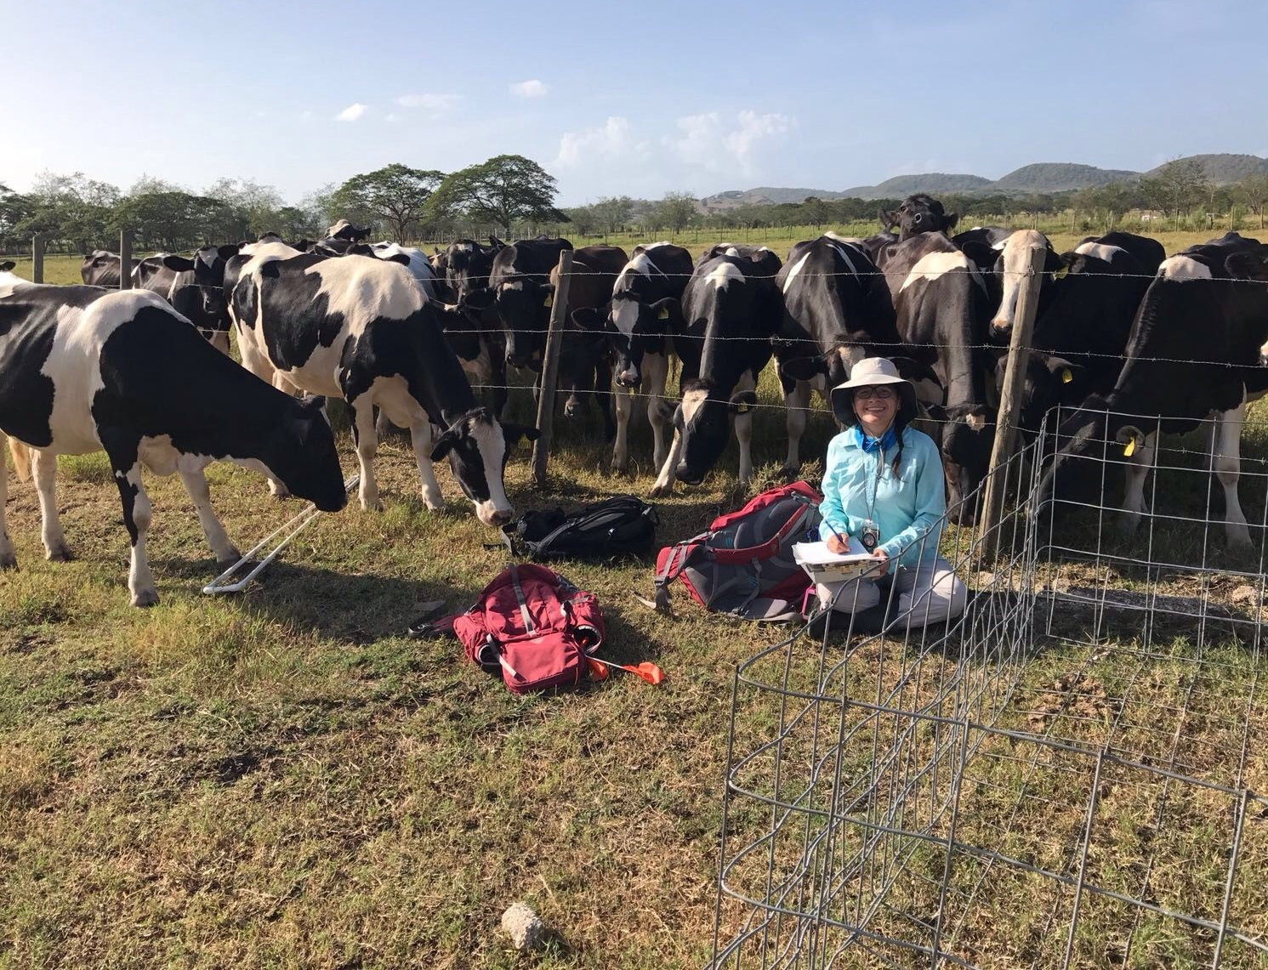
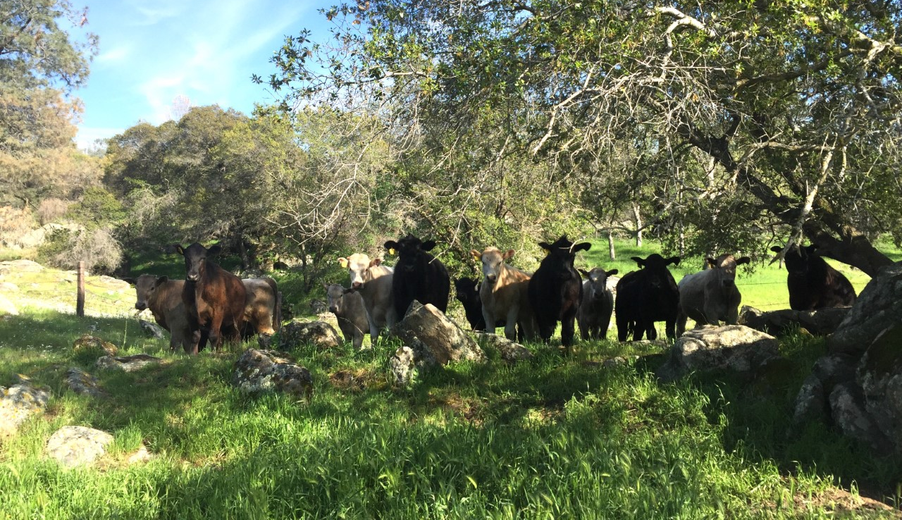
Data for land use management
NEON field sites colocated with LTAR sites
Interactions of agricultural activities and native ecosystems
Cows at SJER, California
Cows at LAJA, Puerto Rico
Notes:
NEON data could be used in food security
Cows and croplands dominate large portions of the U.S. How does this agriculture impact ecosystems? NEON field sites located on or near agricultural land – including some colocated with Long-Term Agroecosystem Research (LTAR) sites and Agricultural Research Stations – can help answer important questions about the interactions between agricultural activities and native ecosystems.
Agricultural land, including both pasture land and cropland, makes up more than 44% of the total area of the U.S. With so much land devoted to livestock and crops, it's important to understand how different agricultural practices impact the ecosystem. Agricultural sites within the Observatory allow comparison between wilderness and farmlands within the same Domain or enable monitoring of the impact of different land-use models, such as high-intensity vs. low-intensity grazing.
For example, NEON and LTAR staff ran side-by-side comparisons of their respective soil sensors in 2017 at CPER to inform data quality investigations. More recently, in May and June 2021, NEON and LTAR program staff co-led a virtual workshop series funded by the National Science Foundation that brought a diverse group of scientists together to identify the potential and priorities for integrating the resources of these and other research networks to advance understanding of managed and unmanaged lands at regional to continental scales.
https://www.neonscience.org/impact/observatory-blog/down-farm-and-range-neon

Slide 20









Partnerships & Collaborations across the sciences
Partner Types:
Data Host
Information Partner
Network Partner
Education
Contracted Partner
Data Project
Global environmental research infrastructures
Notes:
NEON partnerships are another way that we support the community. NEON continues to expand its collaborative partnerships with other research platforms, observatories, research centers, or networks. Not only does this lower barriers to collaboration, but it improves the chances for innovation. We have well over 100 active partnerships – of these different types:
Data host: A data repository that hosts NEON data, either through submission by NEON or direct harvest of NEON data. May also generate and provide data products derived from NEON data.
-- Ameriflux: NEON’s most widely used data, Surface-Atmosphere Exchange (SAE), are harvested by Ameriflux and posted on their website. They are developing six derived data products (temporally interpolated products) that we will make available on the NEON data portal. via AmeriFlux, NEON Terrestrial Instrument System (TIS) sites became registered with the FLUXCOM globally gridded flux initiative (Jung et al., 2020). This is fundamental to move NEON TIS data from NEON field sites into community models (Metzger, 2019) with data from hundreds of other sites.
-- StreamPulse: brings in several of NEON's freshwater data products through its API for use – along with many others – for river and stream metabolism synthesis research.
Information partner: An organization that NEON affiliates with for the purpose of obtaining help with or sharing ideas about best data and information management practices. CUAHSI is an information partner: share data and information standards and other practices with them. CUAHSI is now (Sept 1, 2020) the Coordinating Hub for the Critical Zone (CZ) Collaborative Network. Dynamic Water Storage in western montane watersheds.
Network partner: A network that NEON affiliates with for the purpose of improving research, e.g., LTER, LTAR
--LTAR: NEON sites are colocated with many LTAR locations. Already working together, but would like to increase collaboration: agricultural activities across the Observatory, beyond co-located sites
--LTER:
Education: An organization that develops or co-develops educational materials using NEON data, EDSIN
Contracted partner: An organization that is contracted to develop key products for NEON, MGRAST
Data project: An organization that harvests, uses, or shares NEON data for particular types of research programs
Site Hosts: We don't own land; all of these orgs are groups that we have good working relationships with – from gov agencies to nonprofits to universities, private landowners.
Diverse groups that we collaborate with, from gov to non-profit
Federal (USFS, USFWS, DOE, Army Corps, US Coast Guard, BLM, NPS) Site Agreements: 32
University/Institution: 26
Private (Including foundations, institutions, State and City): 28
275 total permits as of January 19, 2018
DOE:
Ameriflux:
NEON’s most widely used data, Surface-Atmosphere Exchange (SAE), are harvested by Ameriflux and posted on their website. They are developing six derived data products (temporally interpolated products) that we will make available on the NEON data portal. Further, in March 2020 via AmeriFlux, NEON Terrestrial Instrument System (TIS) sites became registered with the FLUXCOM globally gridded flux initiative (Jung et al., 2020). This is fundamental to move NEON TIS data from NEON field sites into community models (Metzger, 2019) with data from hundreds of other sites.
EMSL:
Partnership with Environmental Molecular Sciences Laboratory (a DOE user facility) to target synergies between the NEON biorep and the high powered instrumentation at EMSL and the Joint Genome Institute. The call went live this year and should repeat in the future.
NASA:
NEON MALIBU (a joint project of NASA’s Terrestrial Ecology Program, NOAA/NESDIS/STAR, and BlackSwift technologies) is using NEON data to verify that the satellite-derived time series data we are getting from above are accurate and reliable over time. WE deliver our data through Aeronet. MALIBU is part of a major and ongoing investment by NASA GSFC to develop enhanced multi-angular remote sensing techniques using small Unmanned Aircraft System (s-UAS) platforms.
JPL: (2011) NEON contracted with JPL for imaging spectrometers needed to complete the instrumentation to fully operate its Airborne Observation Platform (AOP).
ABoVE: Arctic Boreal Vulnerability Experiment. NEON has been called essential to the program, the data from our field sites in Alaska.
AERONET: Our CIMEL data products are generated and hosted in partnership with NASA .
USDA:
LTAR: NEON sites are colocated with many LTAR locations. Already working together, but would like to increase collaboration: agricultural activities across the Observatory, beyond co-located sites
NRCS: Natural Resources Conservation Service. At each site we collect intact blocks of soil to calibrate the soil moisture sensors to the local soil type. To do this we dig a single temporary soil pit at each terrestrial site, collaborate with local NRCS soil scientists to identify the different soil horizons, and collect up to 6 intact blocks representative of different soil horizons. These blocks of soils were used to calibrate soil sensors and generate diffusivity values. We also collected samples for the megapit archive (which are availble). NRCS also did a one time site-wide survey.
NOAA:
NOAA uses NEON data in several line items: Global Monitoring Division, National Centers for Environmental Information (formerly NCDC), National Data Buoy Center, and National Geophysical Data Center.

Slide 21




















Sample Analysis ~30 Partners
Notes:
We partner with approximately 30 different labs to conduct sample analyses and a subset of those partners are pictured here

