Slide 1
A visual guide to accessing NEON data
Please view included slide notes throughout the presentation for additional details
Updated 6 February 2020
Notes:
This guide walks viewers through how to access data through the NEON data portal and a few related resources for working with NEON data. The NEON data portal remains in dynamic development. This photographic guide will be regularly updated. If the data portal you are viewing does not match this guide, please check for an updated version.
The guide is laid out to be followed sequentially from starting on the NEONScience.org website to downloading data to your computer. After this sequence additional slides are provided that provide details on other pages or topics of interest to data users.

Slide 2
Slideshow Sections
Discover NEON Data
Explore and Download NEON Data from Data Portal
Special Cases for Downloading NEON Data
Understand Downloaded Data Structure
Additional Important Pages & Information

Slide 3
Discover NEON Data
NEONScience.org
data.NEONScience.org
Notes:
This section highlights key resources provided on neonscience.org and data.neonscience.org. You will want to familiarize yourself with both sites to better understand how NEON collects and provides data.

Slide 4
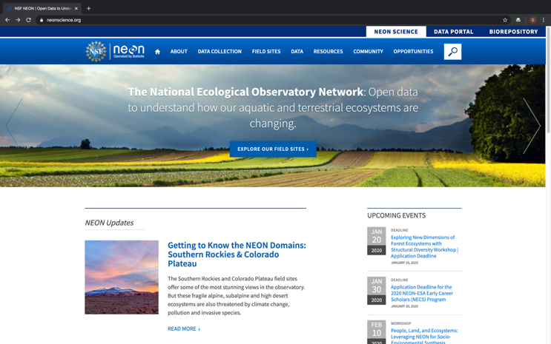
NEONScience.org
Overview of data collection
Field site maps
Information for researchers
Using NEON Infrastructure
Access to the NEON Data Portal
Notes:
We start the journey to downloading NEON data from the NEONScience.org homepage. The main NEON website, NEONScience.org, provides many resources for researchers and educators interested in NEON including direct access to the data portal.
Data Collection – introductory information to how NEON collects data. A good place to start to understand what types of data NEON collects or determine if the data NEON collects is what you want for your research or teaching.
Field Sites – The field site maps and list will help you gain familiarity with the sites. If you are interested in data from particular locations, identify the four letter codes for each site of interest, you will need these when selecting the data for these sites.
Data – Information on NEON data, samples & specimens, data policy, and more. Includes of the the other links to get to the data portal.

Slide 5
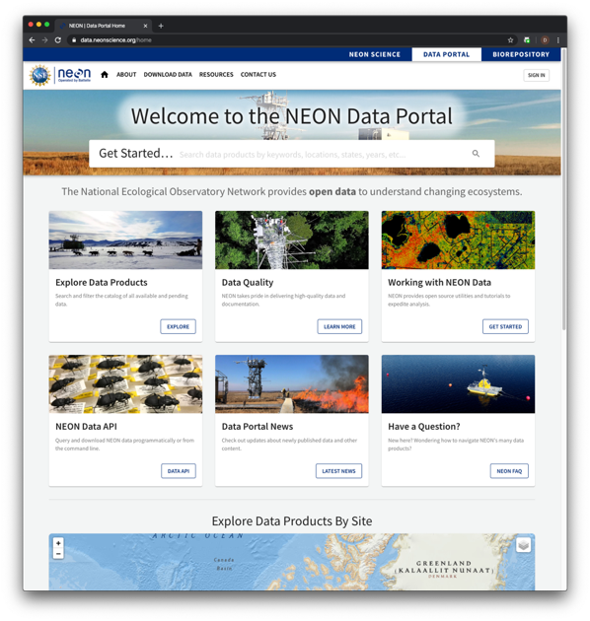
Data.neonscience.org
Explore and download data
Information on programmatic access to NEON data
API
Code packages
Access data product user guides, detailed protocols, and other important documents
News on product updates and versions
Notes:
The NEON data portal, at data.neonscience.org, is the place to explore and download NEON data products as well as find the detailed information about all NEON data products. We will go through many of these pages in more detail.

Slide 6
Explore & Download Data From Portal
Explore Data Page
Download Tabular Data Including:
Instrumented Sampling
Observational Sampling
Notes:
In this section, we will go through steps to explore and download NEON data from the Data Portal.

Slide 7
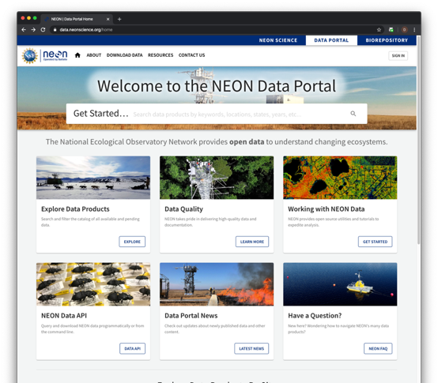
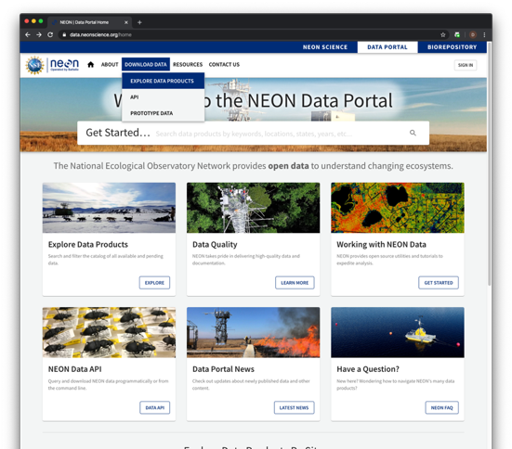
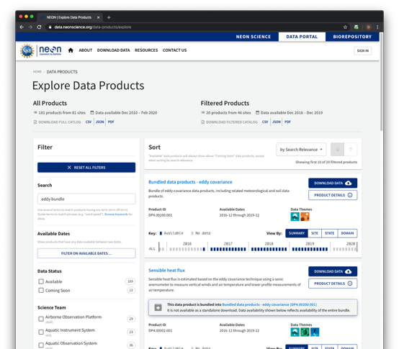
Explore data
Step 1
Step 2
Step 3
Notes:
Start your NEON data exploration on the Explore Data Products page. The direct URL is https://data.neonscience.org/data-products/explore .
(This slide contains animations to fully view each step)
Step 1: The fastest way to access NEON data from this page is by clicking on the Explore Data Products link here.
Step 2: Or, you can choose Download Data -> Explore Data Products.
Step 3: You are now in the data explorer. Proceed to next slide.

Slide 8
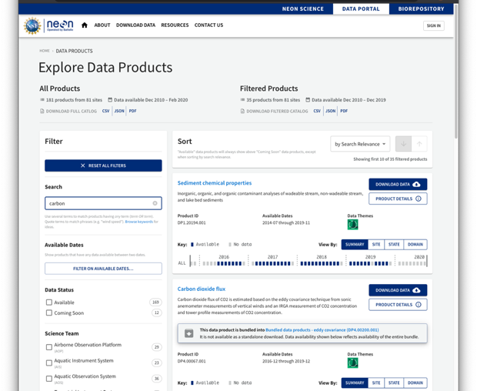
Explore data: Filter to find data products of interest
Remove all filters
Results of searching for “carbon”
Filter by keyword
Filter by category
Data status
Themes
States
Domains
Sites
Data teams
Notes:
To begin, choose keyword(s) or select from the available categories to filter to NEON data products of interest to you. Alternatively, you can scroll down through data products when there are no filters selected to view all of NEON’s data products.
When using the keyword search, if you don’t get the result you are interested in try a related word or shorter phrase. For example, if you are interested in small mammal data from live trapping, you’ll find that “trapping data” returns zero data products, while “small mammals” returns two data products (“Small mammal box trapping” and “Small mammal sequences DNA barcode”) and simply “mammals” returns three data products (the two previous plus “Rodent-borne pathogen status”).

Slide 9
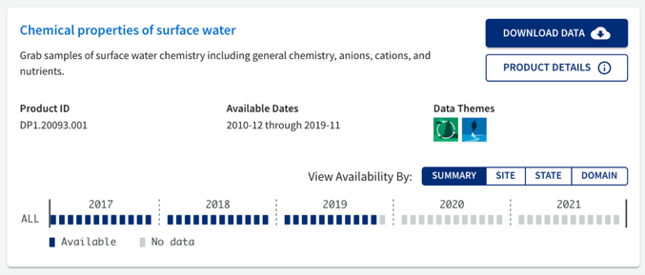
Explore data: Key information
Associated data themes
Data product name
Move to next step to download data
Summary information
Data product number
Data availability by month
Blue: currently available for download
Grey: not available for download
Date range for which data are currently available to download
Go to data product page to get details & associated documents
Notes:
Each data product window provides a variety of useful information and links to other useful information.
Key among these are the data product name and data product number. Both are important for referring to your data and looking up the data in the future.
Product Details is a link that takes the user to the Product Detail Page (see page specific slide for details). Clicking the data product name will take you to the same page.
The Available Time Range and Availability bar icons are both related to what is available for download from the data portal at the current time. All data are distributed in per month packages therefore, each bar represents one calendar month. Blue month boxes mean that data are currently available for use. The grey boxes could mean that data were never collected and will never be available, data were collected but have not been processed but will be availability in the future, or that the specific months occur in the future (a full year shows up at a time).

Slide 10
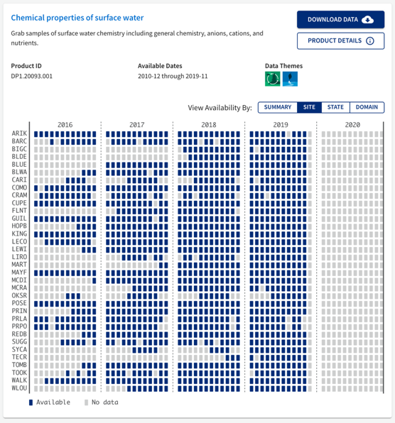
Explore data: View data availability
Notes:
You can view the availability of NEON data as an overall summary or by site, state, or domain. A given site, state, or domain will only appear if it is available for at least one month for that data product. If you are only interested in data from select locations, you can click on those locations here to select them for download or you can do that in the next step.
If you are interested in only specific locations, you will need to know the four-letter code for these sites. These can easily be looked up on the field site map (https://www.neonscience.org/field-sites/field-sites-map) or list (https://www.neonscience.org/field-sites/field-sites-map/list).

Slide 11
Configure data download - Part 1
Select Download Data when you are ready to configure a data download
Notes:
Select Download Data when ready to configure your data set to download. You can only configure and download one data product at a time in the data portal.
There are a few data products, primarily phenocam data, that cannot currently be downloaded from the Explore Data page. When you select “Download Data” for these data products, you will be reverted to the previous explore data page. For details on how to configure this data for download, see the slide “Configure AOP data for Download” or “Configure Data Hosted by Partner”.

Slide 12
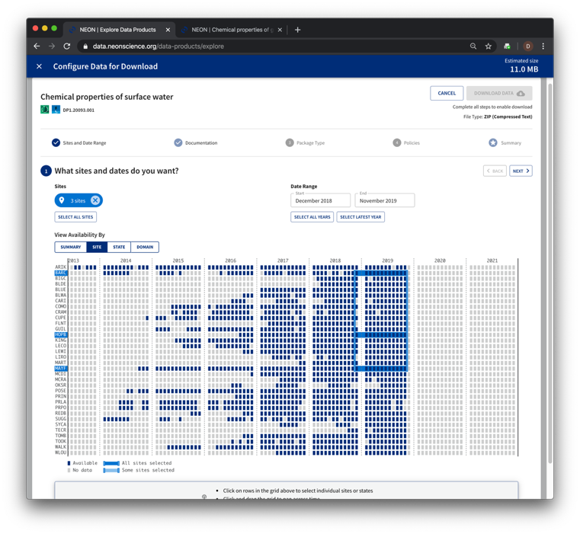
Configure data download - Part 2
1.1 Select date range of interest
1.2 Select area(s) of interest by clicking on appropriate line(s)
1.3 Click the ‘Next’ button.
Notes:
When you select “Download Data” on the Explore Data page, a pop up window will appear where you will configure your data set.

Slide 13
Configure data download - Part 3
2. Select inclusion of documents
3. Select document package type
4. Agree to NEON policies
Notes:
Include documents? This will provide PDFs of related documents (User Guides, Protocols, Algorithm Theoretical Basis Documents, etc) in the folder that you are downloading. We recommend you do this on the initial download of a data product so that you readily have this important information for use while using NEON data. All related documents can also be found on the Documents tab of each Data Product Details page (see slide for more details).
Basic vs Expanded Data Type? Basic data include an overall data flag for the overall quality of the data. The expanded data types have additional data tables and data flags regarding specific processing steps or data control analyses. For research purposes, you will likely want the expanded package. For educational or initial data exploratory, the basic package is likely sufficient.

Slide 14
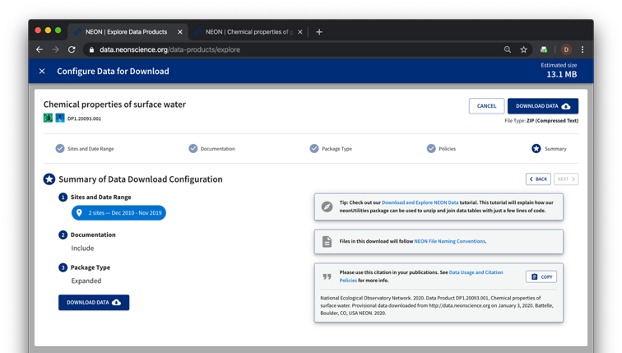
Configure data download - Part 4
5. Check file size
6. Click Download Data
7. Use the recommended citation!
Notes:
Given the timeframe and types of data collected, NEON data product packages can quickly become very, very large. We recommend always checking the estimated download size BEFORE starting any download.
Please cite NEON data in your work – it helps NEON to sustain our funding to continue to provide you with high-quality data!

Slide 15
Special Cases for Downloading Data
Aerial Observation Platform (AOP) Data:
LiDAR
Hyperspectral
Aerial Imagery
Phenocam & Genomics Data from Partner Organizations
Notes:
In this section, we will go through some special cases for downloading NEON data

Slide 16
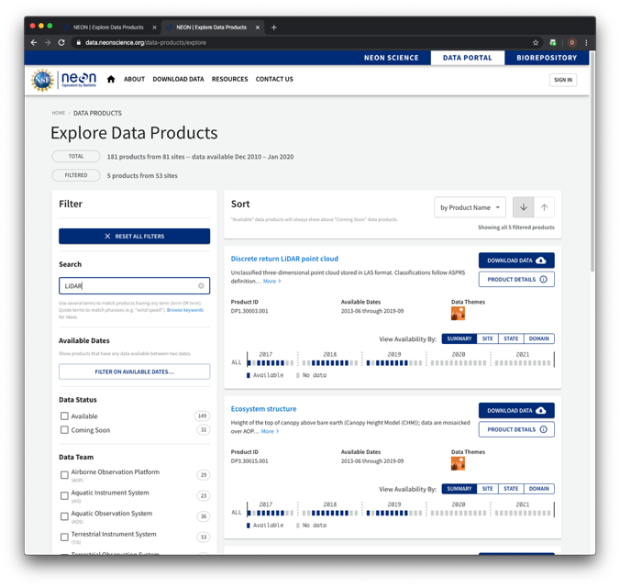
Aerial Observation Platform (AOP) Data
NEON’s remotely sensed data, such as lidar, hyperspectral, and aerial imagery data, are very large files. NEON delivers them as 1km² tiles or flightlines.
To download this data, in addition to data product, site, and date range, you have to select which files you want to download.
You can also explore some types of AOP data through a visual browser.
Notes:
Note that our AOP datasets may be VERY LARGE! Start by downloading one at a time. We recommend downloading these files programmatically, however, you may want to explore a small subset of the data by downloading through the portal.
Select Download Data when ready to configure your data set to download. You can only configure and download one data product at a time in the data portal.

Slide 17
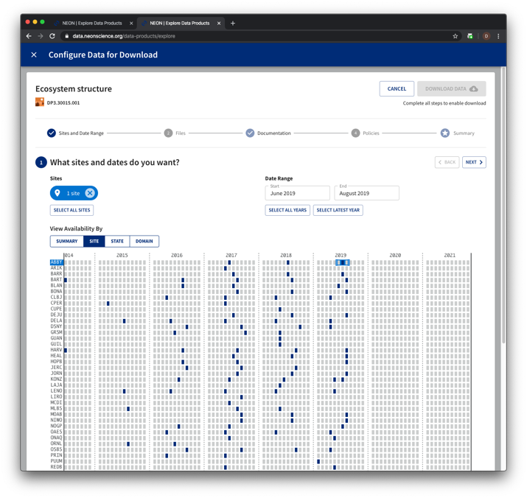
Configure data download - Part 1
1.1 Select date range of interest
1.2 Select area(s) of interest by clicking on appropriate line(s)
1.3 Click the ‘Next’ button.
Notes:
There are many ways to specify the particular data that you are looking for – here we show an example using the ‘Site’ interface for View Availability.
Note that our AOP datasets may be VERY LARGE! Start by downloading one at a time.

Slide 18
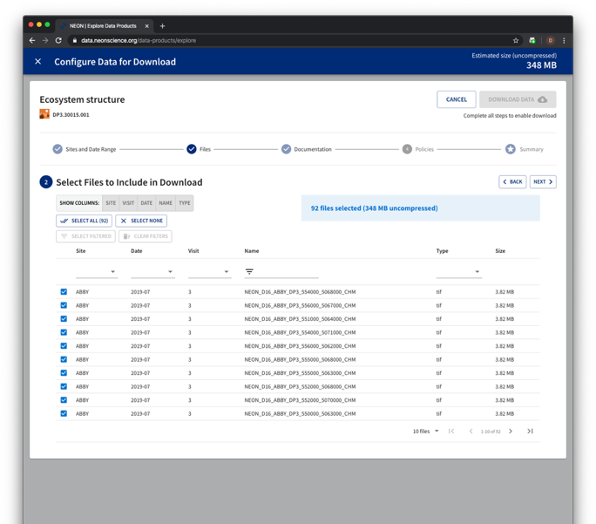
Configure data download - Part 2
2.1 Select all files in package, or subset by Site, Date, Visit #, Name, or file Type
2.2 Check the estimated file size!
2.3 Click Next when ready
Notes:
Here we see that there are 92 individual files available for ABBY in 2019., including the readme .txt file, for a total of 348 MB.
The file name also specifies location, using the UTM zone’s easting and northing for the lower left corner of the tile. See more information about file naming conventions here: data.neonscience.org/file-naming-conventions

Slide 19
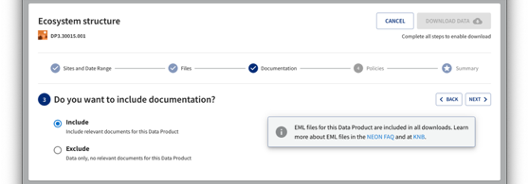
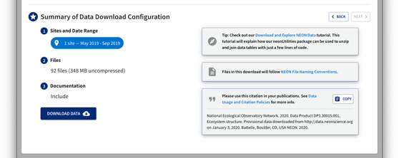
Configure data download - Part 3
3. Select inclusion of documents
4. Agree to NEON policies
5. Ready to download
Notes:
Include documents? This will provide PDFs of related documents (User Guides, Protocols, Algorithm Theoretical Basis Documents, etc.) in the folder that you are downloading. We recommend you do this on the initial download of a data product so that you readily have this important information for use while using NEON data. All related documents can also be found on the Documents tab of each Data Product Details page (see slide for more details).
Basic vs Expanded Data Type? AOP does not have separate ‘Basic’ or ‘Expanded’ package types, so you will not be prompted as per the instructions above.

Slide 20
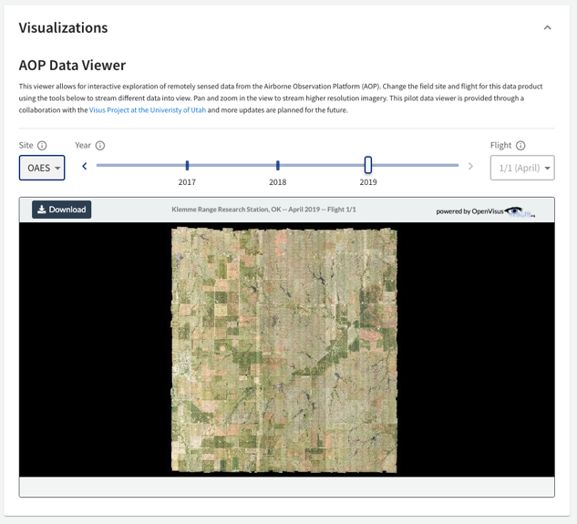
Explore through visual browser
Explore mosaicked camera and hyperspectral imagery
Available on the Data Product Detail Page
Current download options: only can download .png or binary files
Partnership with University of Utah’s ViSUS team – availability of data product that this is for will be expanding
Two products available to browse:
High-resolution Imagery:
https://data.neonscience.org/data-products/DP3.30010.001
Vegetation indices:
https://data.neonscience.org/data-products/DP3.30026.001

Slide 21
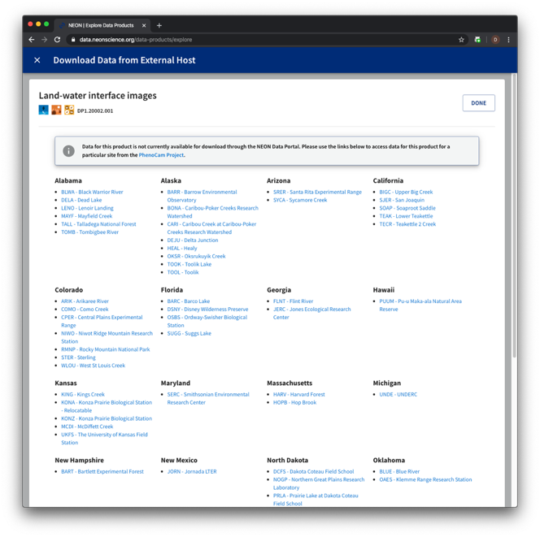
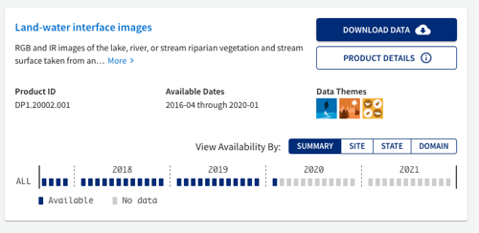
Download Phenocam Data
1. Select your dataset of interest
2. Follow the links provided
Notes:
Phenocam Data are provided through the PhenoCam Project: https://phenocam.sr.unh.edu/webcam/about/.
Links on the Download Data process will link you directly to their portal.

Slide 22
Understand Downloaded Data Structure

Slide 23
Use downloaded data: Structure
Uncompressed
Most NEON data products are delivered as compressed (zipped) .csv files.
Other formats include .hdf5 and .tif
Uncompress to view the contents
Data in compressed site by month files
For each site by month, there may be multiple related data tables per data product.
Uncompressed
Notes:
The data will download to your default download location (likely your Downloads folder).
Most NEON data products are delivered as compressed (zipped) .csv files. Other formats include .hdf5, .tif, and .kmz. These next few slides only pertain to the data products delivered compressed with data in .csv files. For all compressed files, view them by uncompressing.

Slide 24
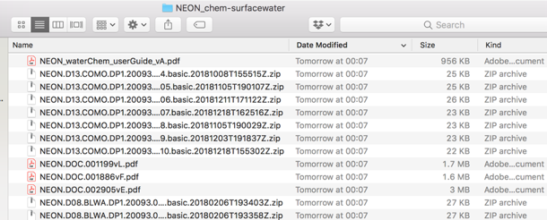
Use downloaded data: Key files
Uncompressed
Included documentation (if selected)
User Guide, Protocol, etc.
Validation file
Contains the data processing rules
EML (.xml) file
Machine readable metadata file
Readme file
Important information on the download
Data table(s)
One or more related .csv files
Variables file
Lists which variables are found in which data table
Uncompressed
Notes:
Included documentation (if selected)
The User Guide, Protocol, etc. – Exact files vary by data product. All files can also be found on the Data Product Details page.
Information in the User Guide is specifically designed to help users work with NEON data.
Validation file
Contains the machine readable data processing rules –
EML (.xml) file
Machine readable metadata file. More about EML at NEON (http://data.neonscience.org/faq) and KNB (http://ecogrid.ecoinformatics.org/external//emlparser/docs/index.html).
Readme file
Important information on the data product and includes information on the specific download.
Data table(s)
One or more related .csv files
Variables file
Lists which variables are found in which data table. This can be very useful for figuring out how to link the related data tables.

Slide 25
Use downloaded data: Stack data
Use neonUtilities R package to combine all site by month files.
Tools to help (see notes)
Super simple script for beginners
Using neonUtilites with Python
Data tutorial on neonUtilites
neonUtilities::stackByTable()
Notes:
When downloaded from the portal, data come in site by month files. We know that it is difficult to work with all these separate files, so NEON provides the neonUtilities R package which contains the stackByTable function to combine the files so that you only have one of each type for all dates and sites.
Tools to help you use this tool:
Not an R user? No worries, we have a super simple script for beginners: https://www.neonscience.org/resources/code-resources (scroll down to Super Easy R Script to download)
Prefer to use Python and not R? Not a problem, follow these directions to use the R package functionality within Python: https://www.neonscience.org/neon-utilities-python.
Want to learn about the many tools that neonUtililities has to offer for working with NEON data? This data tutorial is for you:https://www.neonscience.org/neonDataStackR.
This concludes the sequential series of slides to explore, download and access NEON data.

Slide 26
Additional Important Pages
Accessing NEON Data Programmatically
Making the Most of your NEON Account
NEON Data Policies – How to Cite
Data Product Detail Pages
File Name Conventions Page
Data Quality Pages
Notes:
In this section, we will go through steps to access additional information about the NEON data.

Slide 27
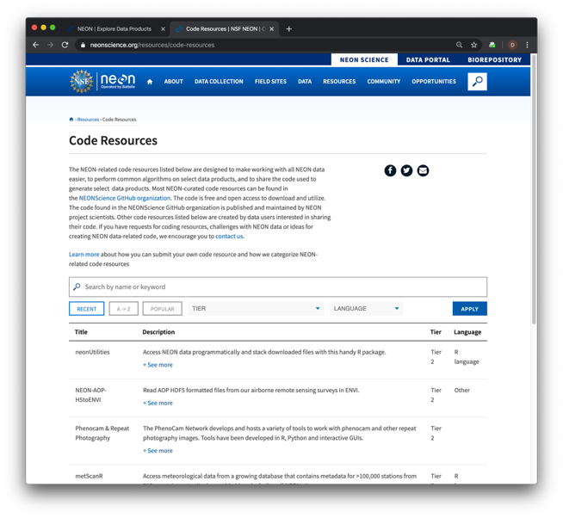
Programmatic access to NEON data
Use the NEON API
Learn More: data.neonscience.org/data-api
Use the neonUtilities R package
Functions to directly access NEON data (not just stack downloaded files)
Available on CRAN
Data tutorial: www.neonscience.org/neonDataStackR
Additional tools
github.com/NEONScience
Code Resources
Notes:
This guide primarily discusses how to access NEON data from the data portal. However, data can also be accessed programmatically using several tools. For more question, please use our Contact Us form:
General NEON questions: https://www.neonscience.org/observatory/contact-us
Data portal/API specific questions: http://data.neonscience.org/feedback

Slide 28
NEON Data Account
Take advantage of optional account features while helping NEON achieve our mission.
Review your download history to easily update your research with the latest data, and forward your queries to collaborators around the world
Help NEON track data usage for anonymized reporting to our funding agency, the National Science Foundation
Your data are yours! Retrieve your data or delete your account any time
To read more about how we secure and respect your information, please visit: https://www.neonscience.org/data/about-data/data-portal-user-accounts
Notes:
You can make your NEON account by signing in to the data portal using the button on the top-right corner of your screen.

Slide 29
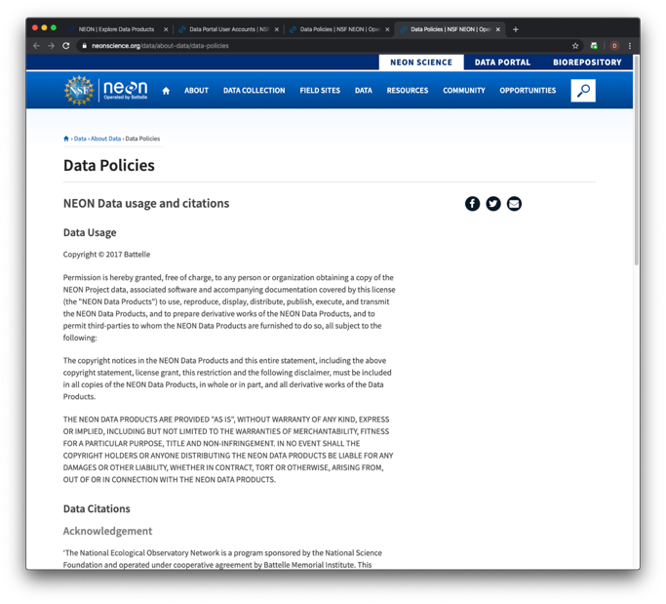
NEON Data Policies
By using NEON data, you agree to appropriately cite these products.
Please see our detailed citation, acknowledgement, copyright, and table styles at:
https://www.neonscience.org/data/about-data/data-policies
Notes:
By using NEON data, you agree to appropriately cite these products according to the rules found here: https://www.neonscience.org/data/about-data/data-policies

Slide 30
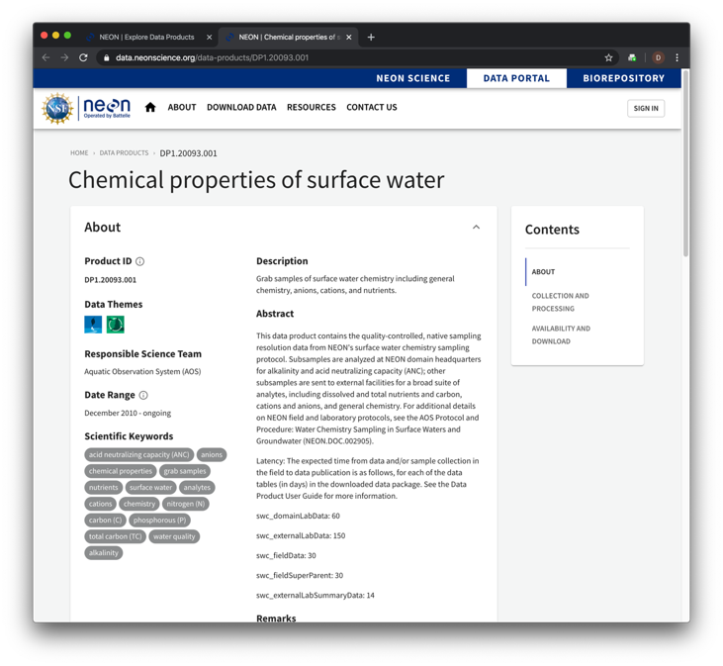
Data product details
These pages provide you with information regarding any NEON data product.
Contents:
About: Overview information including product ID, data themes, keywords, a brief description, Abstract, additional remarks, and the data citation
Collection and Processing: details about the observatory-wide collection, including relevant documentation and instrumentation types
Availability and Download: similar to the interface shown in the previous slides
Notes:
Data product detail pages can be accessed from the Browse Data page by clicking on the View Product Details text or through the main navigation menu (Resources -> Data Product Catalog; then search for the data product of interest).

Slide 31
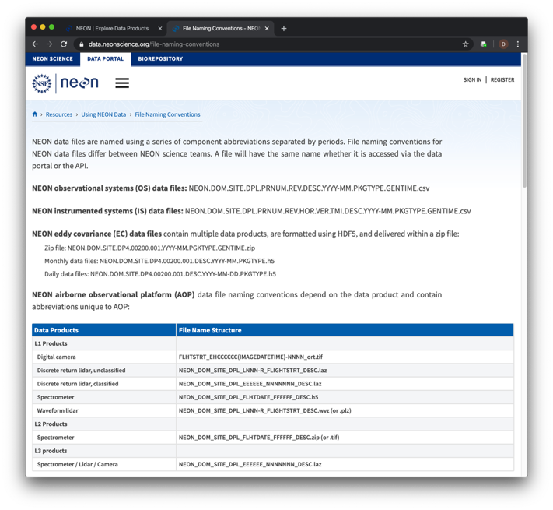
File name conventions
Provides details on standardized names of the data files.
data.neonscience.org/file-naming-conventions
Notes:
All NEON data file names contain specific information. This page provides the information needed to decipher the file names.

Slide 32
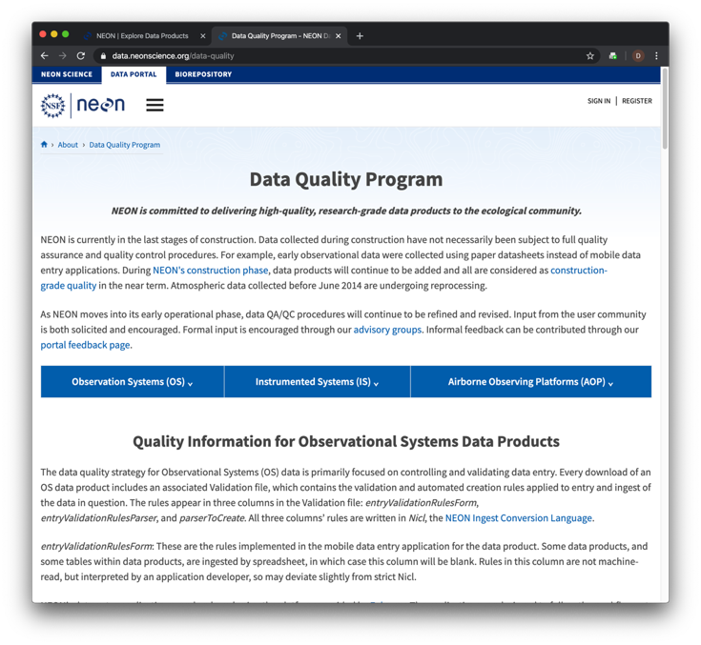
Data quality
Learn how NEON ensures quality, reliable data.
data.neonscience.org/data-quality
Notes:
In addition to the information on this page regarding data quality, we have three videos that explain the data processing steps:
Observational Sampling: https://youtu.be/82-scTZsyeY
Instrumented Systems: https://youtu.be/0crRkvQWu3E
Airborne Observation Platform: https://youtu.be/f5e-X9dMnXs

